Slide 1
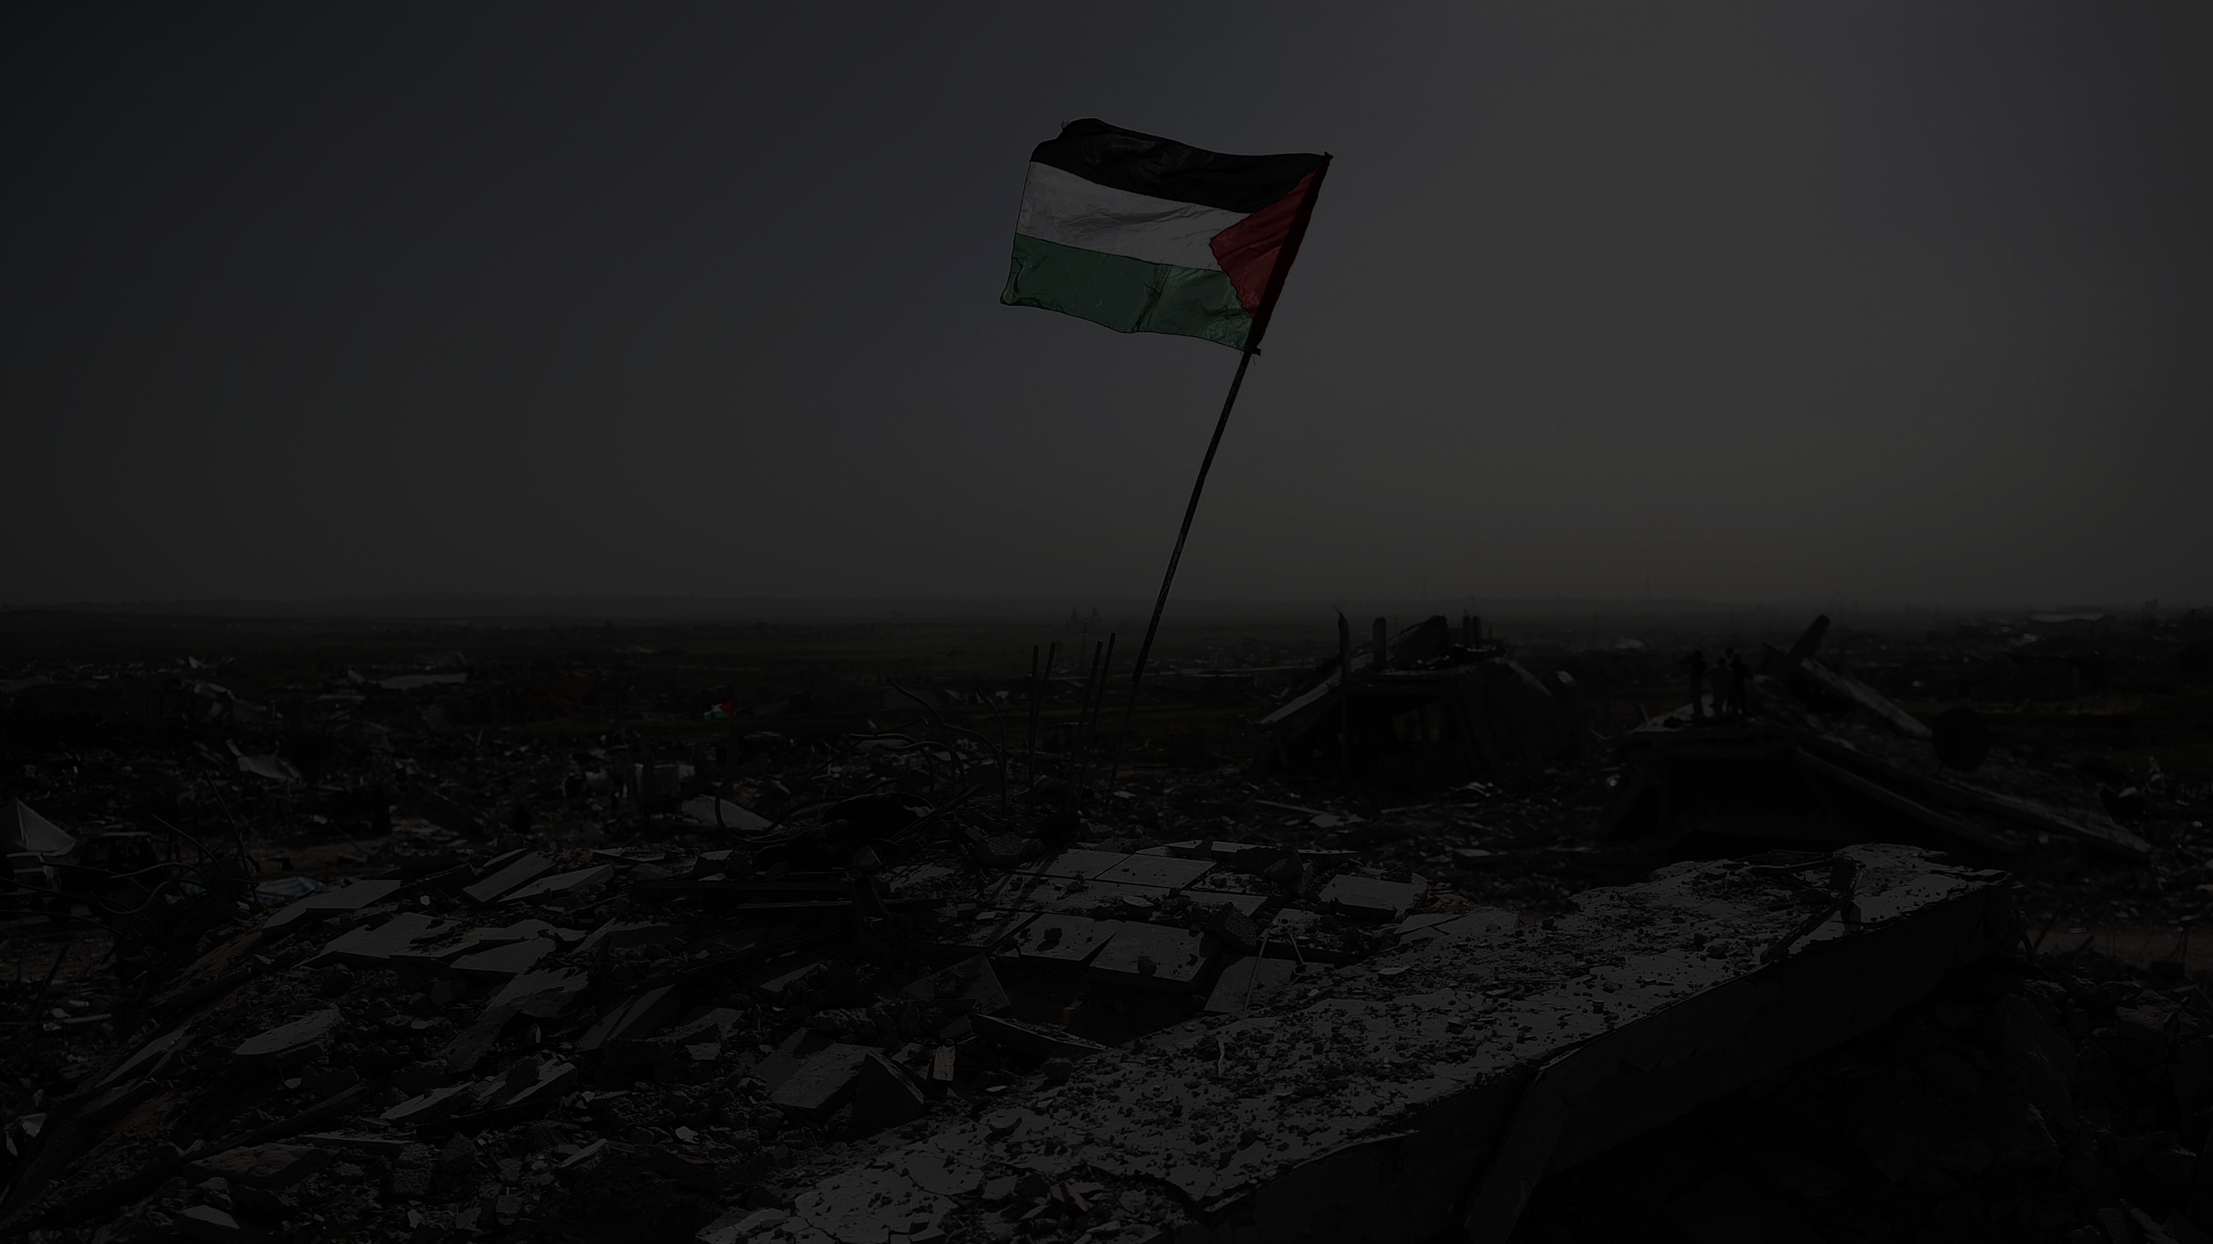
Rule-Based Expert System for Post-War Building Assessment in Gaza
Walid K. W. Alsafadi
University College of Applied Sciences

Slide 2

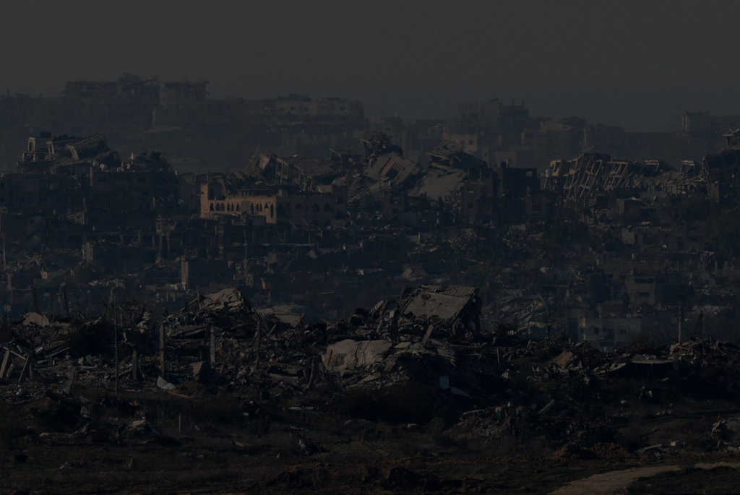
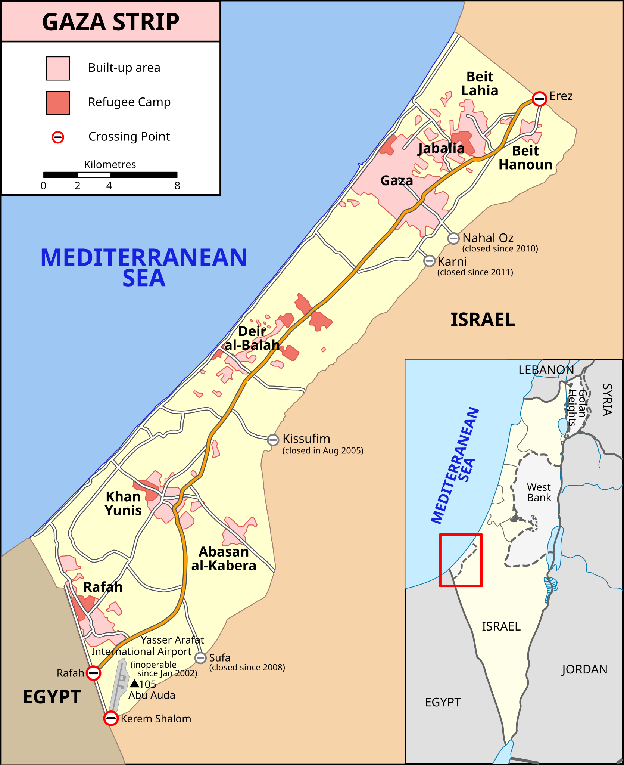
Introduction
Conflicts cause severe damage to urban areas, making recovery difficult. In Gaza, a densely populated region home to over two million residents, prolonged conflict has devastated infrastructure. Social challenges, such as poverty, overcrowding, and displacement, highlight the urgent need for innovative tools to guide reconstruction. This project uses a rule-based expert system to assess building conditions and prioritize rebuilding efforts.
Rule-Based Expert System for Post-War Building Assessment in Gaza
Walid K. W. Alsafadi
University College of Applied Sciences

Slide 3

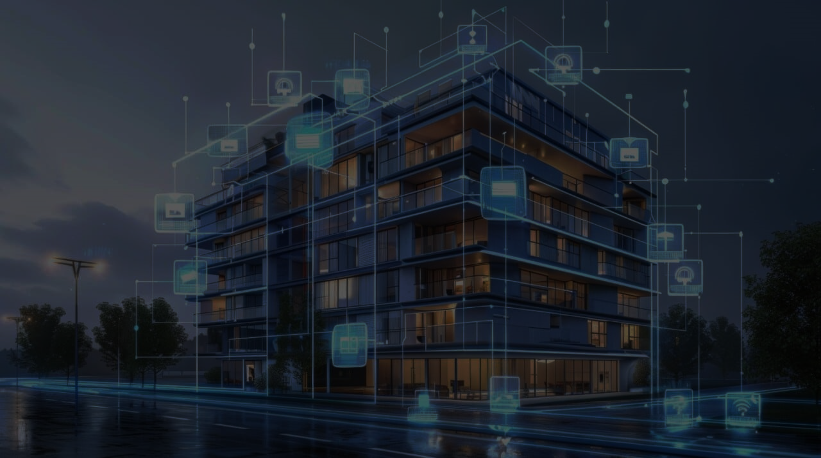
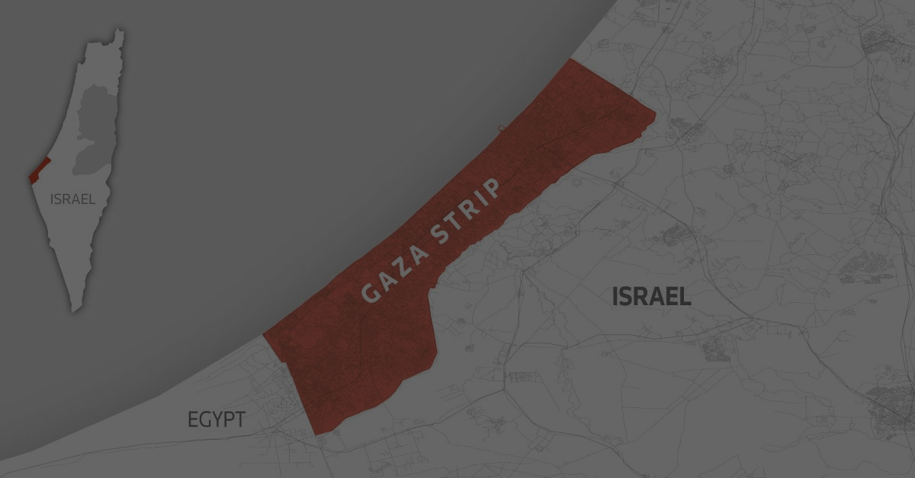
Expert System Overview
Introduction
The expert system helps prioritize reconstruction efforts in Gaza.
It applies 43 rules across six categories:
Structural, Environmental, Social, Utility & Infrastructure, Data & Assessment, and Design & Sustainability.
Rules are based on global standards like FEMA and USGS, ensuring reliability.
Designed to address challenges such as structural damage and social vulnerabilities.
Conflicts cause severe damage to urban areas, making recovery difficult. In Gaza, a densely populated region home to over two million residents, prolonged conflict has devastated infrastructure. Social challenges, such as poverty, overcrowding, and displacement, highlight the urgent need for innovative tools to guide reconstruction. This project uses a rule-based expert system to assess building conditions and prioritize rebuilding efforts.

Slide 4


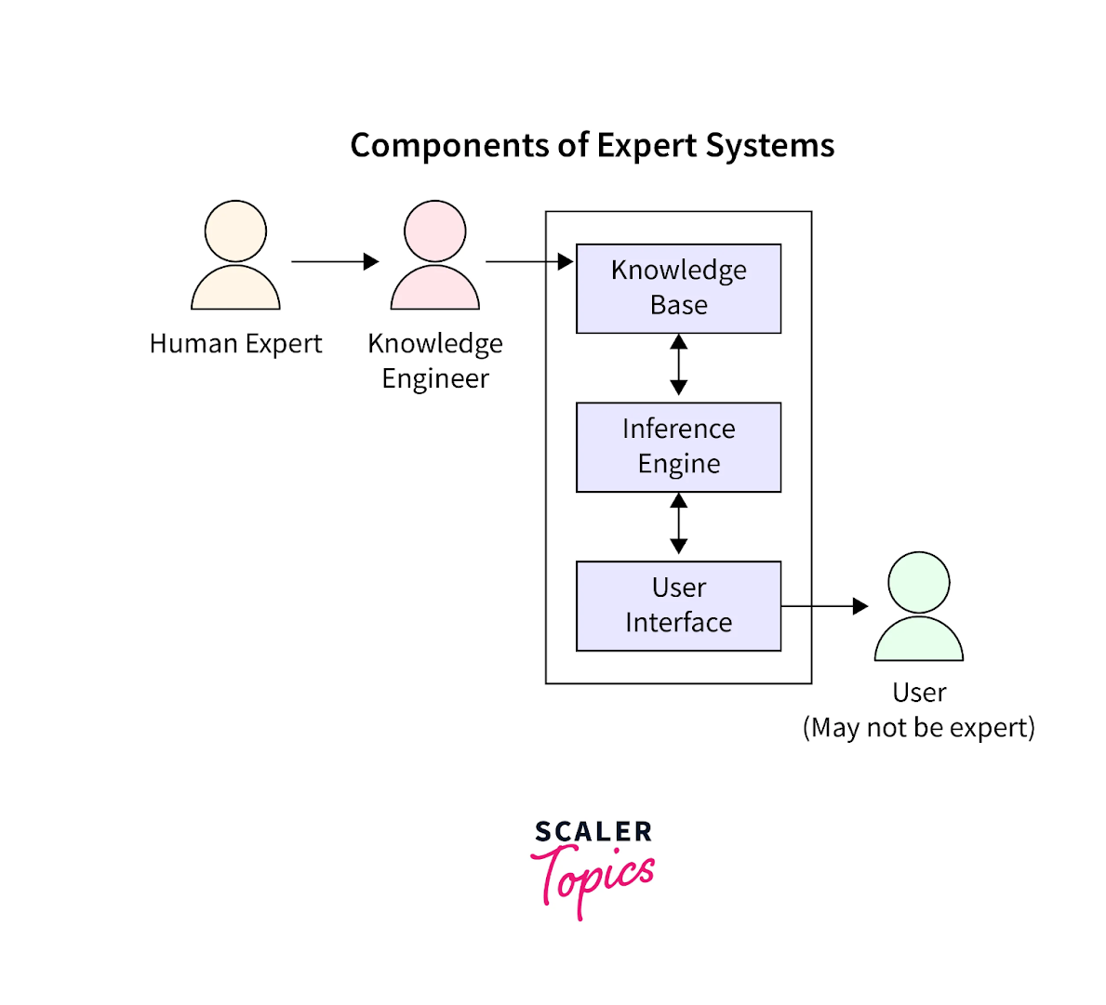
Key Features
Expert System Overview
Inference Engine: Uses forward-chaining to evaluate facts and trigger relevant rules.
Combined Rules: Handles interconnected risks (e.g., hazardous zones and structural damage).
Uncertainty Handling: Employs confidence levels and fuzzy logic for robust recommendations.
User-Friendly Interface: Built with Streamlit for real-time input and recommendations.
Accessible for decision-makers in Gaza and similar conflict-affected areas.
The expert system helps prioritize reconstruction efforts in Gaza.
It applies 43 rules across six categories:
Structural, Environmental, Social, Utility & Infrastructure, Data & Assessment, and Design & Sustainability.
Rules are based on global standards like FEMA and USGS, ensuring reliability.
Designed to address challenges such as structural damage and social vulnerabilities.

Slide 5


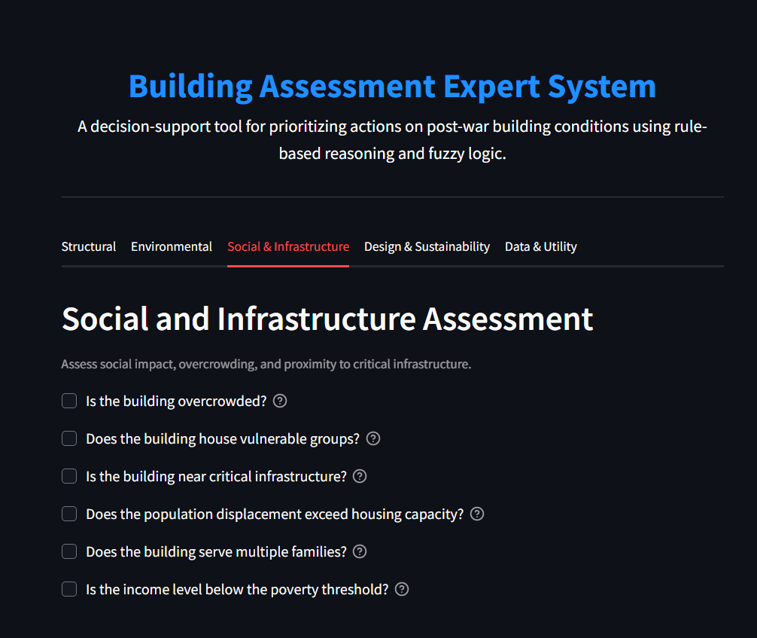
Applying the Rules in the Expert System
Key Features
How the System Works:
Users input structural, environmental, or social data.
The system evaluates the input against 43 rules.
Recommendations are prioritized based on confidence and severity.
Example: Structural Damage Assessment
Input: Severe SAR backscatter detected.
Output: Priority 85.0: Critical - Immediate Repairs Required (SAR Detected).
Key Features:
Interactive Inputs: Easily select building conditions.
Dynamic Results: Real-time prioritized actions.
User-Friendly: Clear recommendations for decision-making.
Inference Engine: Uses forward-chaining to evaluate facts and trigger relevant rules.
Combined Rules: Handles interconnected risks (e.g., hazardous zones and structural damage).
Uncertainty Handling: Employs confidence levels and fuzzy logic for robust recommendations.
User-Friendly Interface: Built with Streamlit for real-time input and recommendations.
Accessible for decision-makers in Gaza and similar conflict-affected areas.

Slide 6

Users input structural, environmental, or social data.
The system evaluates the input against 43 rules.
Recommendations are prioritized based on confidence and severity.
Applying the Rules in the Expert System
Challenges Faced During Development
Rule Formulation:
Crafting 43 rules based on reliable sources like FEMA and MDPI.
Adapting rules to address Gaza's unique post-conflict challenges.
Testing and Debugging:
Managing interdependencies in combined rules.
Extensively testing edge cases to ensure system reliability.
Fuzzy Logic Integration:
Handling uncertainty with confidence levels and fuzzy logic.
Resolving errors during implementation and calibration.
Scalability and Maintenance:
Balancing rule complexity with usability.
Ensuring adaptability for future needs.
User Interface Design:
Developing an intuitive, user-friendly Streamlit UI.
Aligning technical functionality with a seamless user experience.
How the System Works:
Users input structural, environmental, or social data.
The system evaluates the input against 43 rules.
Recommendations are prioritized based on confidence and severity.
Example: Structural Damage Assessment
Input: Severe SAR backscatter detected.
Output: Priority 85.0: Critical - Immediate Repairs Required (SAR Detected).
Key Features:
Interactive Inputs: Easily select building conditions.
Dynamic Results: Real-time prioritized actions.
User-Friendly: Clear recommendations for decision-making.

Slide 7
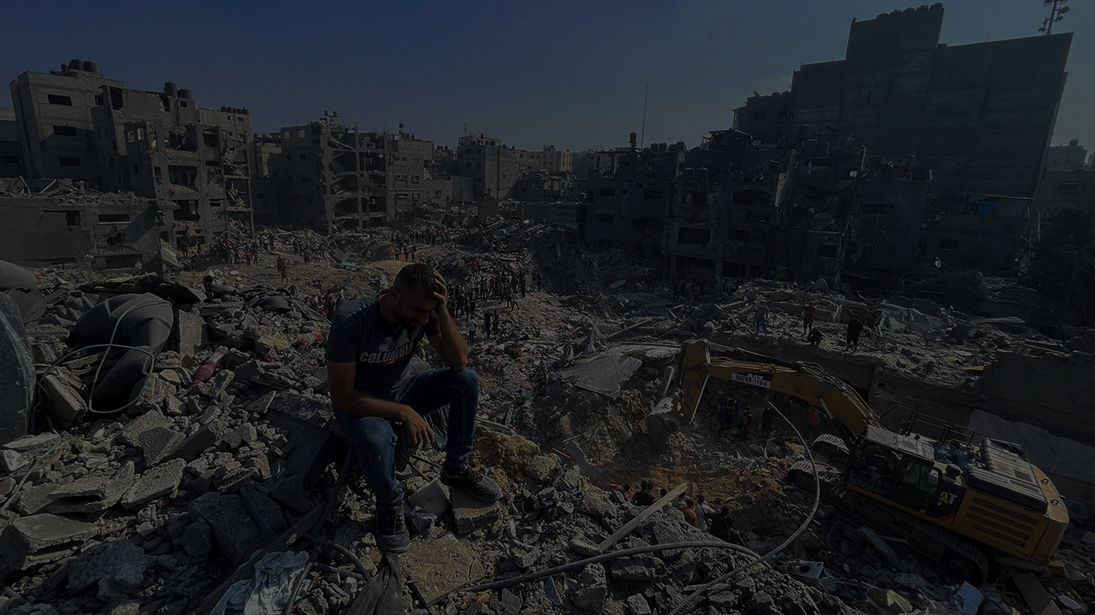

Challenges Faced During Development
Conclusion
Key Outcomes:
Developed a robust rule-based expert system for post-war building assessment in Gaza.
Integrated structural, environmental, and social factors into actionable recommendations.
Delivered a user-friendly interface for real-time decision-making.
Innovations:
Combined rules to address interconnected risks (e.g., hazardous zones and structural damage).
Applied fuzzy logic to handle uncertainty effectively.
Built a scalable solution tailored to Gaza’s post-conflict challenges.
Rule Formulation:
Crafting 43 rules based on reliable sources like FEMA and MDPI.
Adapting rules to address Gaza's unique post-conflict challenges.
Testing and Debugging:
Managing interdependencies in combined rules.
Extensively testing edge cases to ensure system reliability.
Fuzzy Logic Integration:
Handling uncertainty with confidence levels and fuzzy logic.
Resolving errors during implementation and calibration.
Scalability and Maintenance:
Balancing rule complexity with usability.
Ensuring adaptability for future needs.
User Interface Design:
Developing an intuitive, user-friendly Streamlit UI.
Aligning technical functionality with a seamless user experience.

Slide 8


Conclusion
Key Outcomes:
Developed a robust rule-based expert system for post-war building assessment in Gaza.
Integrated structural, environmental, and social factors into actionable recommendations.
Delivered a user-friendly interface for real-time decision-making.
Innovations:
Combined rules to address interconnected risks (e.g., landslide risk and critical infrastructure).
Applied fuzzy logic to handle uncertainty effectively.
Built a scalable solution tailored to Gaza’s post-conflict challenges.
Thank you!
Name: Walid K. W. Alsafadi
Email: walid.k.alsafadi@gmail.com
GitHub Repo: BuildingAssessment-ExpertSystem
Project Demo: building-assessment-es.streamlit.app
LinkedIn: in/WalidAlsafadi
May peace prevail in Gaza and all around the world.

Slide 9
Thank you!
Name: Walid K. W. Alsafadi
Email: walid.k.alsafadi@gmail.com
GitHub Repo: BuildingAssessment-ExpertSystem
Project Demo: building-assessment-es.streamlit.app
LinkedIn: in/WalidAlsafadi
May peace prevail in Gaza and all around the world.

